Slide 1
STOCHASTIC PROCESSES
Lecture 1 CC: Ms. Shiza Riaz Memon

Slide 2
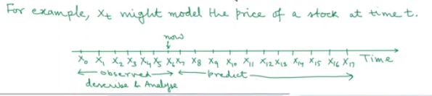
What is Stochastic Process?
Also called random process
A stochastic process is a family or set of ordered random variables.
The order is indicated by indexing each random variable in the family by a subscript
Usually the ordering is a result of the random variables being observed over time, so xt is a random variable that models the value of the stochastic process at a time t.
The random variables in the set can be dependent on one another reflecting the nature of the process being modelled.

Slide 3
Random Variable
A random variable is a variable whose value is unknown or a function that assigns values to each of an experiment's outcomes.
A random variable can be either discrete (having specific values) or continuous (any value in a continuous range).
Why is it called a random variable?
So the random variables are called random because the value of this variable cannot be defined with certainty, we can only make a guess and this guess is called the probability of having a particular value of a random variable. In coin toss experiment, P(X=1) = 0.5.

Slide 4
Stochastic Process
A stochastic Process is a collection of random variables {xt ; tET} defined on the same probability space.
Sample space is a collection or a set of possible outcomes of a random experiment.
The set T is called the index set or time set or time domain
For each tET , xt is a random variable and it denotes the state of the process at time t.
The set of values that the random variables xt are capable of taking is called state space of the process and is denoted by S.
Let St be the set of all possible values of xt for tET.
Normally, we have St=S (i.e independent of t),
Otherwise, we take S= U (tET) St

Slide 5
Examples
Example 1: Let Xn be the temperature in Degree Celsius recorded in Karachi at 12 pm on nth day. The state space of the stochastic process {Xn: n>/1} can be taken to be S={20-45). Here T={1,2,3…..}.
State Space is Continuous but Time is discrete. So this is discrete time stochastic process
Example 2: Let Xn be the outcome of the nth toss of a six sided dice. The state space of {Xn: n>1} is S={1,2,3,4,5,6}. Here T={1,2,3…} T is the toss not time.
Both are discrete so this is Discrete time stochastic process

Slide 6
Examples
Example 3: A motor insurance company reviews the status of its customers yearly, Three levels of discounts are possible (0%, 20%, 40%) depending on the accident or claim record of the driver. Let Xn denote the status of a customer after completion of the nth year. The state space of the stochastic process {Xn: n>/0} is S={0,20,40}, Clearly X0 denotes the status of a new customer and xo=0. Here T={0,1,2…..}
State Space is discrete and time is also discrete.

Slide 7
Examples
Example 4: Suppose a machine can be in two states: running or failed. Let Xt be the state of the machine at time t. Then the state space of {Xt:t>/0} is S={running, failed}. Here T=[0,infinity].
State space is discrete but time is continuous
One person cannot measure the state upto infinity but theoretically more than 1 person can do this job.
Example 5: Let Xt be the state {w.r.t to Covid-19} of a person at time t. Then the state space of {Xt:t>/0} can be S= {susceptible, infected, recovered, dead}. Here theoretically we may take T=[0, infinity] but practically T may be [0,150] only.
State space is discrete but time is continuous

Slide 8
Examples
Example 6: Let Xt be the temperature in degrees recorded at Karachi airport at time t. Then the state space of {Xt: t>/0} can be S={20, 45]. Here T=[0, to infinity]
Both are continuous.
Example 7: Let Xt be the value of a stock at time t. Then the state space of {Xt: t>0} is S={0, infinity}. Here T=[0, infinity]. In practice , the stock values are discrete, being integer multiples of 0.01.
Both are continuous

Slide 9
Possibilities of the State Space and Time
Based on the nature of S and T, Stochastic Process can be classified as follows:
1. Discrete Time and discrete state space.
2. Discrete time and continuous state space
3. continuous time and discrete state space.
4. Continuous time and continuous state space

Slide 10
Examples of Possible Stochastic Process
Activity: Students are asked different processes that can be taken an example of the possibilities of state space and time.

Slide 11
Applications of Stochastic Process
Stochastic programs or processes are dynamics that form as a result of probabilistic variations or fluctuations.
It has many applications in the financial sector, characterized by uncertainty in several areas, including securities performance, market volatility, inflation rates, epidemic modeling for diseases like coronavirus, comprehension of disease transmission, traffic simulations, and electrical engineering communications and signal processing. More stochastic processes and their applications are discussed below:
Many financial planners and managers use it to predict security and market behavior.
Traffic simulations are done using it.
One also uses it in epidemic modeling, like in coronavirus.
It also gets applied in mobile cellular networks, communications, and signal processing of electrical engineering.
Finding the present guidelines for when and how much to order would be a stochastic process.
The corporation would have to modify and reevaluate these procedures until they produce a more favorable result if they are not successful—if a company frequently had too much or too enough inventory.
In condensed physics, one uses it to describe a phenomenon accurately.

Slide 12
Examples
The second example comprises a bus BlueCouch which takes students to and from the dormitory complex, allowing the student’s union to arrive many times during the day. Bus BlueCouch has an intake capacity of 50 students at one go. If the student’s number is fifty or little lesser, then the bus makes them board it. However, when the number of students exceeds 50, then only fifty students will get to board the bus, and the remaining will wait for the next round of the bus.
One can see that the number of students waiting for the empty bus to board its destination takes the form of a random process. Moreover, when one counts the time of bus arrival, then the number of students in a queue for bus arrival also forms a random process. Furthermore, when one considers the number of students in the queue for a bus at any given the time of day has the continuous space parameter. Hence, in this case, also, the process describes a distinct state of the random process concerning continuous time.
Lastly, in this example, the nth student reaching the bus stop has a certain time associated with them. Thus, the nth student waiting time also forms a continuous-state random process.

Slide 13
Stochastic Modelling
Stochastic modeling develops a mathematical or financial model to simulate an entire system and derives a set of possible outcomes with its probability distribution.
The stochastic modeling definition states that the results vary with conditions or scenarios.
The modeling consists of random variables and uncertainty parameters, playing a vital role.
It brings the probability factor in the calculation, which determines every possible outcome.
For the probability determination of each result, the inputs are given variation from time to time.
Thus, it contributes to the computation of probability distributions which are mathematical functions that reflect the similarity of different outcomes.
For example:
The stochastic prototype provides several outcomes, and it is applied commonly in analyzing investment returns.
First, it studies the market volatility based on the uncertain input and probability of various returns.
Thus, stochastic modeling in finance helps investors discern the unknown outcomes that usually do not consider in the analysis.
The variable is generally time-series data depicting the difference between historical data, and the final distribution result describes the inputs’ randomness.

Slide 14
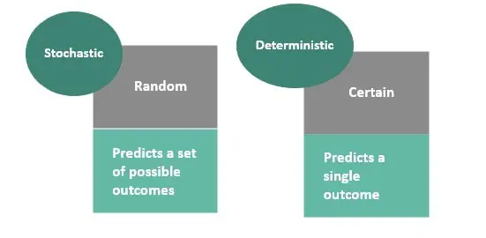
Stochastic vs. Deterministic Modeling
The prime difference between stochastic and deterministic representation is noticeable in the name itself.
The word “stochastic” indicates a random probability distribution, whereas “deterministic” indicates the absence of randomness.

Slide 15
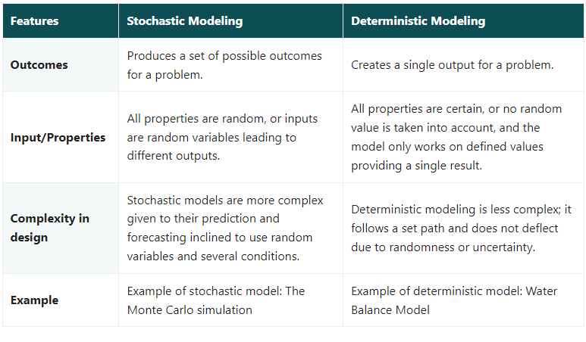

Slide 16
Monte Carlo Simulation
The Monte Carlo simulation is a probabilistic model that can include an element of uncertainty or randomness in its prediction.
When you use a probabilistic model to simulate an outcome, you will get different results each time.
For example, the distance between your home and office is fixed.
However, a probabilistic simulation might predict different travel times by considering factors such as congestion, bad weather, and vehicle breakdowns

Slide 17
Uses of Stochastic Modeling
The application of stochastic modeling has a broad scope and importance in different fields and areas of study. Some of the prominent uses of it are as follows:
Investment decisions: Stochastic modeling in finance is predominantly associated with investment decision-making. It is used in financial analysis to decide on investment decisions, return on investment, etc. The model provides the probable outcomes corresponding to various scenarios.
Agriculture: The model is used in the agriculture field for effective decision-making during uncertain situations. For example, its application in farmland and irrigation management increases farmers’ profit.
Weather forecasting: The application of stochastic approaches in substantial weather and climate prediction prototype is proven, and stochastic predictands can correct many of the inaccuracies in the other frameworks.
Manufacturing: Stochastic replicas of a wide range of manufacturing systems are used for practical examination purposes.
Biochemistry and Systems Biology: Stochastic kinetic methods are used to structure the dynamics of biochemical and biological networks.

